Slide 1
AgricShare SL
A Digital Public Good for Agriculture, inclusive Logistics, and Collaborative Service Networks in Sierra Leone.
CORE CONCEPT: A mobile platform designed to bridge the digital divide, reduce food spoilage, and sanitize the middlemen supply-chain using transparent, trust-based service partner network.

Slide 2
Structural Supply Chain Failures in Sierra Leone
Post-Harvest Waste: Up to 40% of crops rot in agricultural hubs like Kenema and Kabala due to high individual transport costs in Freetown.
Exploitative Middlemen: Unregulated middlemen buy crops at predatory low prices from farmers and resell them at highly inflated retail rates in urban centers.
The Digital Divide: Illiterate or semi-literate rural farmers are locked out of standard smartphone apps.
Youth Unemployment: High rates of unemployed, digitally literate youths in provincial districts

Slide 3
AgricShare SL Ecosystem
Agents: Literate youth list crops for illiterate farmers using Krio Voice(Different ethnic languages in Sierra Leone) & Youth voice recordings, earning a 2% sales commission.
The “Virtual Truck” Aggregation Engine: Groups small crop orders or different people orders into one bulk transit shipment, dropping shipping costs at a lower cost for all people.
Re-engineered Intermediares: Middlemen are transitioned into formal, transparent Service Partners (Logistics, Storage, Hubs).
QR-Verified Mobile Money Escrow: Payments are locked securely via Orange Money/Afrimoney APIs and only released when driver scans the buyer’s QR code.

Slide 4
Software Development Life Cycle
Model Selected: Agile Iterative Model
Why Agile: Designing for multiple distinct
Users (Farmers, Agents, Drivers, Storage
Partners, NGOs) required constant
Feedback loops.
User Research Iteration: Early
Testing showed that farmers struggled
with text-heavy screens, leading directly
To the integration of Krio Voice note
Playback Feature.
Risk Reduction: Allowed use to test
Like the mobile money payment and Hub
Security checks before full Deployment.
1. Requirements & Planning
2. Design (Figma)
3. Iterative Development
4. Testing & Feedback
5. Deployment & Review

Slide 5
The Three-Tier System Architecture
Presentation Layer (User Interface)
*Farmer & Agent Mobile App: (View market prices, post crop listings, Track Transport and price Alerts.
*Driver Mobile App: View available delivery Jobs, accept routes, confirm pickup and Delivery (QR Scanner)
*Buyer NGO Web Portal: Marketplace Catalog, Place Bulk Orders.
*Hub Agent Portal: Manage check-ins, Registers Driver Details (ID, License Plate, Address.
Application /Business Logic Layer
. Web Application Server: Manages API requests from apps and portals.
.Matching Engine: Calculates optimized transport routes and match drivers to Hubs.
.Security & Verification Controller: Validates driver credentials and physical IDs before loading cargo.
.PostgreSQL Database: Stores User Profiles (Farmers, Drivers, Buyers), Transaction histories, Escrow logs, and crop listings.
Firebase Storage: Securely host driver document, license plates, and profile images.
API Integrations: External connections for payment gateaways and SMS notifications.
DATA AND INTEGRATION LAYER

Slide 6
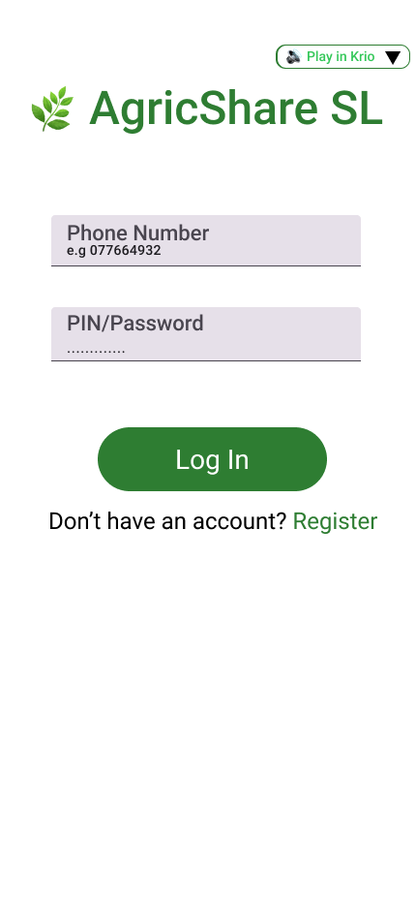
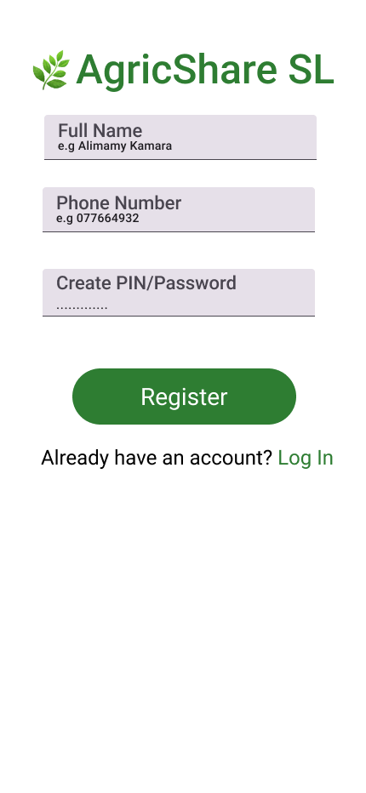
Screens 1 & 2: Login Setup and Main navigation
Low Barrier Access: Phone Number and PIN login (No email needed.
Global Accessibility: Play in Krio or other local languages audio button at the top of interface.
Unified Notifications: Displays active tracking, agent alerts and payout notifications.

Slide 7
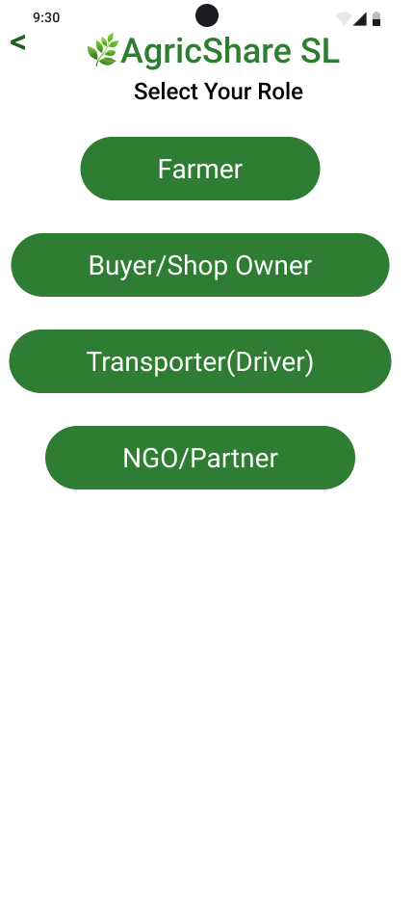
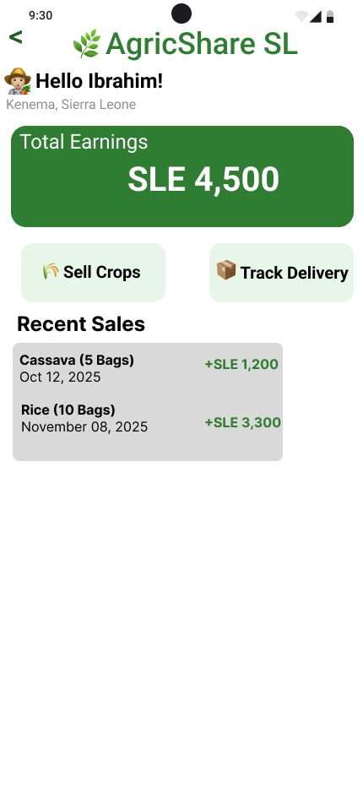
Screen 3 & 4: Role Selection & Farmer Dashboard
Role Selection: Segmented paths for Farmers, Buyers, Drivers, and Service Partners
Farmer/Agent Dashboard: Displays total sales, crop inventory, pending orders, and wallet balance.
Commission Tracker: Transparent 2% commission tracking for Youth Agents

Slide 8
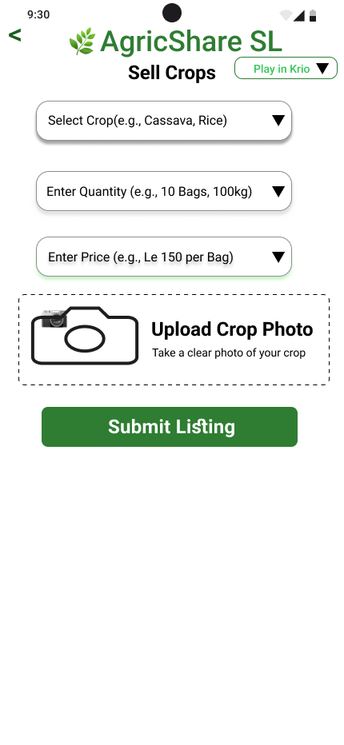
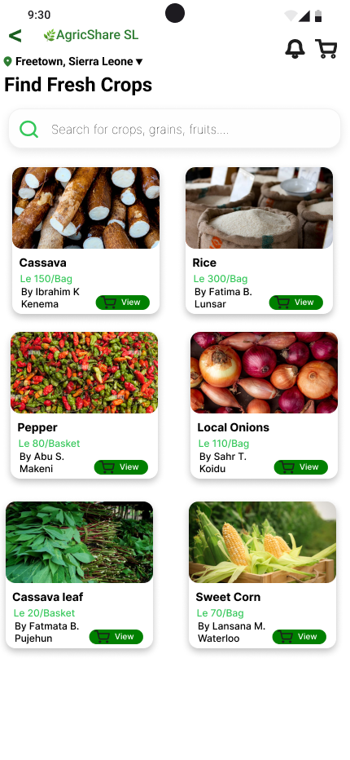
Screens 5&6: Crop Listing & Buyer Marketplace
Sell Crops (Screen 5): Features of voice-recording button for crop descriptions and option settings for Quality Hub Verification.
Marketplace(Screen 6): Shows available local crops, crop quality ratings, and farm-gate pricing.

Slide 9
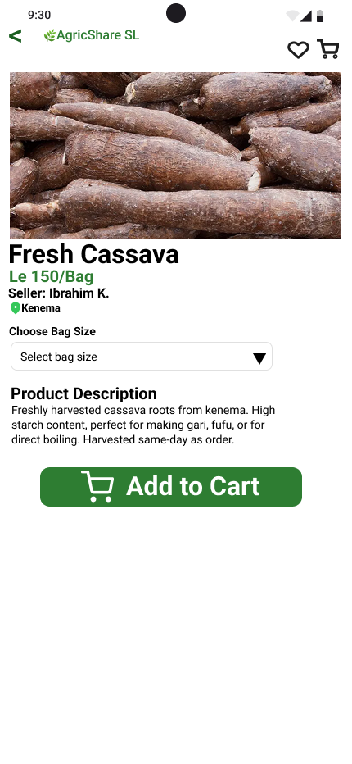
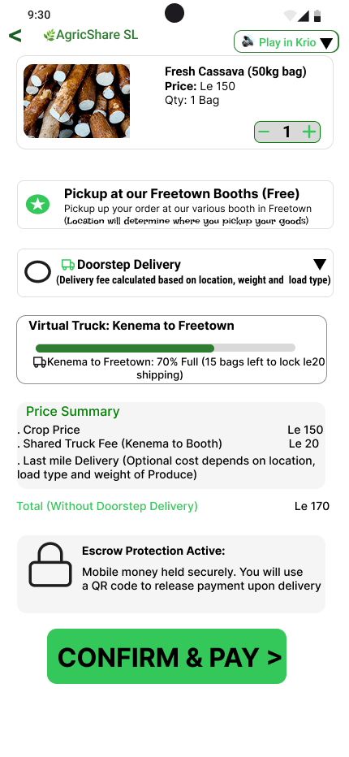
Screen 7 & 8:Product Details & Aggregated Checkout
Screen 7: Product Details
Description: This screen displays comprehensive product details for selected crop listings, including farm gate pricing, weight, quality certifications and the origin hub location. Features Krio Voice Playback
Screen 8: Cart & Checkout
Tracks progress toward the bulk “Virtual Truck” transport discount.
Details split payments and lock funds in the Escrow.

Slide 10
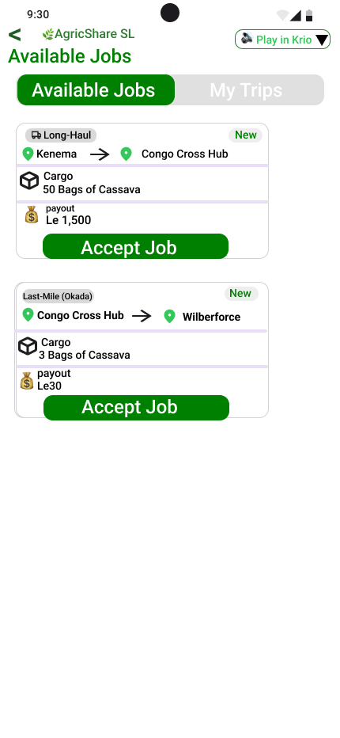
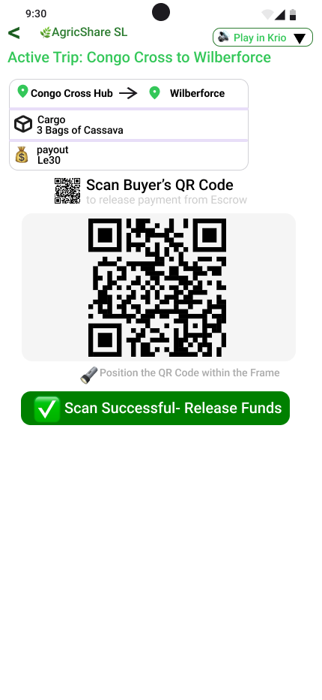
Screens 9 & 10: Driver Dashboard & QR Code Verification
Driver Dashboard (Screen 9): Segments Jobs into Long-Haul runs and last mile Deliveries.
Verification (Screen 10): Driver scans the buyer’s QR Code on Delivery, Triggering the istant release of Escrow funds.

Slide 11
Transforming Intermediaries into Value Providers
Logistics Partners: Local truck owners register to haul bulk cargo and earn guaranteed freight fees instead of buying crops cheap to mark them up.
Hub Agents: Staff collection booths to weigh crops, verify quality, and physically verify driver identities and vehicle registrations to prevent transit theft.
Storage Partners: Local warehouse owners lease cold and dry space for safe storage, earning fixed rental fees.

Slide 12
NGO & BULK EXPORT INTERGRATION (ZERO SPOILAGE)
NGO Interface: Allows humanitarian organizations to purchase near-spoilage or surplus crops at discounted rates.
School Feeding Programs: Routes surplus crops directly to local public school kitchens to minimize post-harvest waste (SDG 2).
Commercial Buyers: Bulk processors purchase wholesale volumes with verified quality and transaction records saved on the database.

Slide 13
PROJECT MANAGEMENT AND TIMELINE
Gantt Chart
Task/Week | W1-2 | W3-4 | W5-6 | W7-9 | W10-11 | W12
1. Requirements
2. Architecture
3. Figma UI/UX
4. Integration & Logic
5. Testing & GIT HUB
6. Submission and Deployment

Slide 14
NETWORK DIAGRAM
Requirements Analysis
Duration: 2wks
Weeks: W1 – W2
B. Architecture
Duration: 2wks
Weeks: W3 – W4
C. Figma UI/UX
Design
Duration: 2wks
Weeks: W5 – W6
E. Testing & GIT HUB
Duration 2wks
Weeks: W10- W11
F. Deployment and Submission
Duration: 12wks
Weeks: 1 week
D. Integration and Logic
Duration: 3wks
Weeks: W7 - W9

Slide 15
Public Code Repository and MIT License
GitHub Repository: Publicly accessible codebase containing database schemas, mobile client codes, and API documentation.
MIT License: Permissive open-source license protecting developer liability while permitting local modifications.
Digital Public Good (DPG): Built to be adapted and expanded by local developers, NGOs, or the Government of Sierra Leone.

Slide 16
Conclusion & System Integrity
System Validation: Core database tables track users, roles, order escrows, and vehicle capacities in a relational structure.
Security & Trust: Driver IDs verified at Hubs; payment locked in mobile money escrow until QR delivery code is scanned by the buyer.
Social Inclusion: Mobile youth agents and Krio voice audio playbacks ensure rural, illiterate farmers are never left behind.

